Slide 1
Joke Recommendation
Team 25
Amrithaa Seshadri, Bowen Sun, Pengpeng Sun, Savitha Srinivasan, Wei-Ru Lin

Slide 2

Motivation
Smart assistants like Siri, Google, and Alexa are pushing to recommend jokes based on user preferences
Humor can be an essential tool to reduce stress/tension
Understanding humor makes computers more ‘user friendly’

Slide 3


Why is it difficult?
What is a ‘good’ joke?
Difficult to formalize humor
Highly subjective

Slide 4
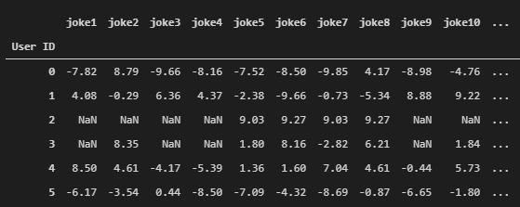
Dataset
Jester dataset for collaborative filtering research, AUTOLab, UC Berkeley
4.1 million ratings of 100 jokes
73,421 users, rating scale: -10.00 to 10.00
A horse walks into a bar. The bartender asks: "So, why the long face?"
Snippet of cleaned data
Sample joke

Slide 5
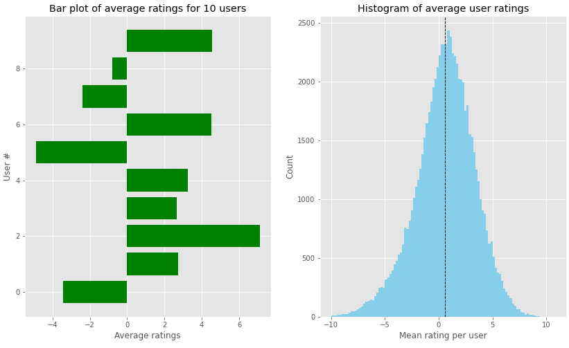
Insights from the Data
Mean = 0.6
User average ratings are not zero centered - need to be normalized
-4.9
Avg ratings for these users are poles apart!
7.1

Slide 6
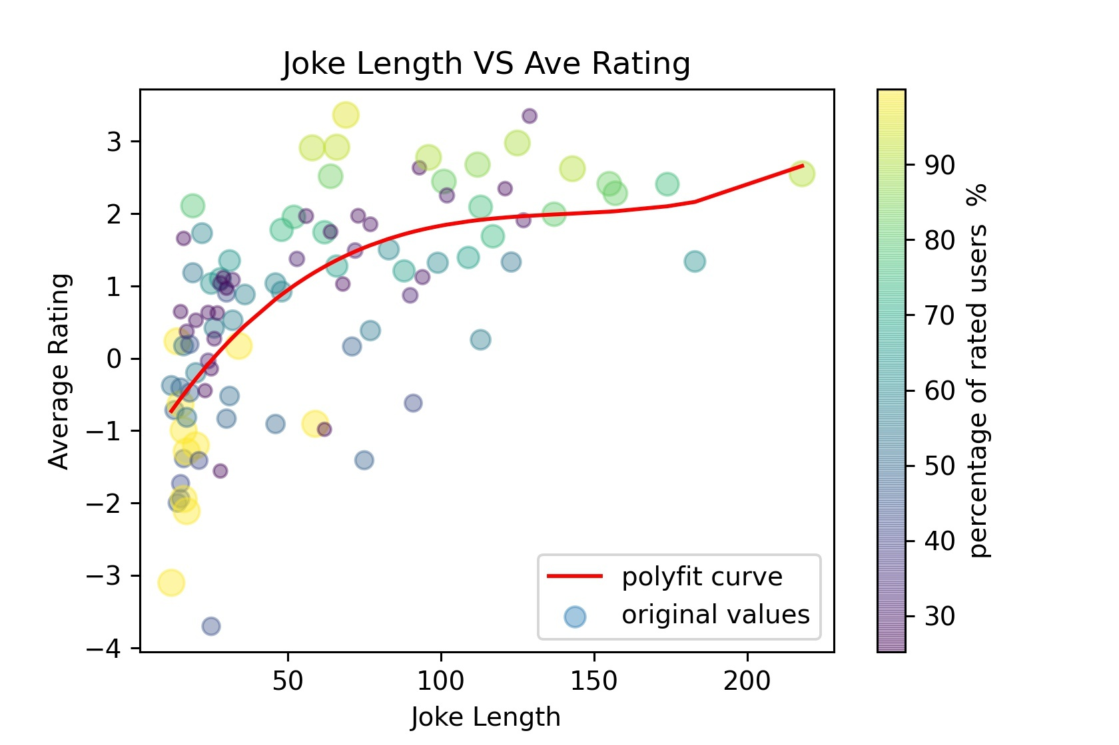
Insights from the Data
Bubble plot showing the effect of the length of a joke on its rating
Size of bubbles represent the number of users who rated the joke
The plot is dense on the left, indicating that most jokes are short!

Slide 7
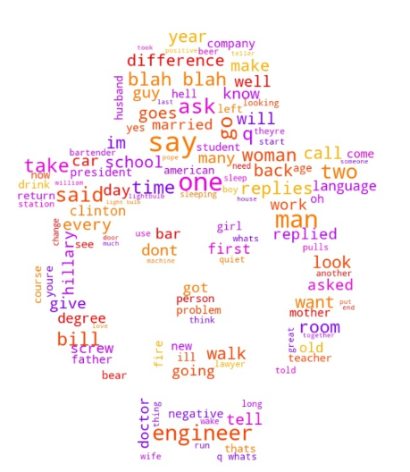
Content Information from Data
Jester was primarily developed for collaborative filtering research
It therefore consists of numerical ratings only, useful for user-user recommendations
To explore content-based recommendations
We extracted keywords based on TF-IDF scores
Categorized jokes into one of 6 genres
Word cloud of text from jokes

Slide 8
Term Frequency-Inverse Document Frequency (TF-IDF)
Statistical measure that reflects the ‘relevance’ of a word to a document
TF: Frequency of the word in the document
IDF: Inverse frequency of the word across a set of documents
TF-IDF = TF * IDF

Slide 9
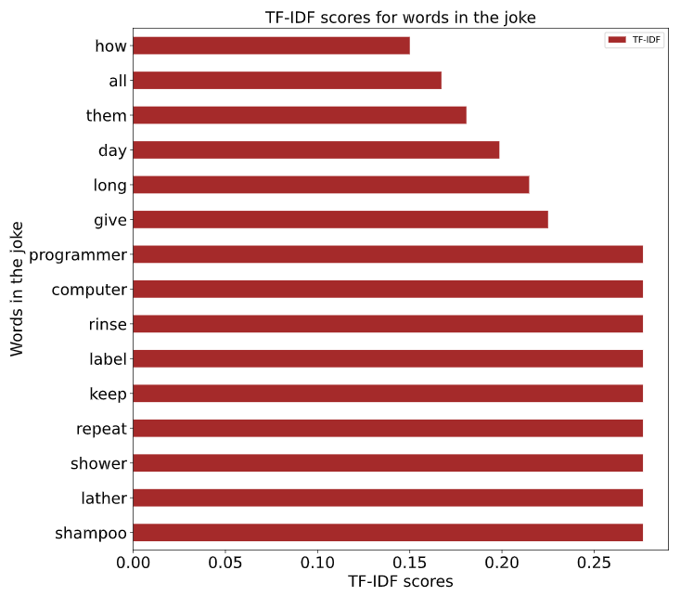
TF-IDF Scores for a Joke
Sample TF-IDF scores for a joke:
Joke 81:
Q: How do you keep a computer programmer in the shower all day long? A: Give them a shampoo with a label that says "rinse, lather, repeat."

Slide 10
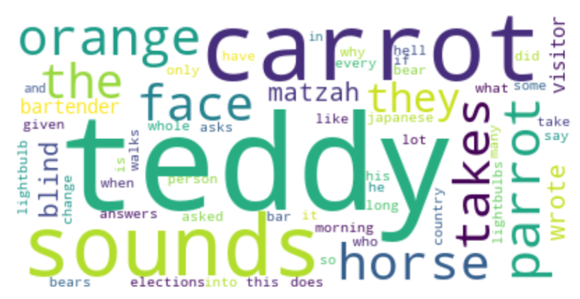
Keywords in the Five Highest Rated Jokes
Word cloud of keywords in five highest rated jokes

Slide 11
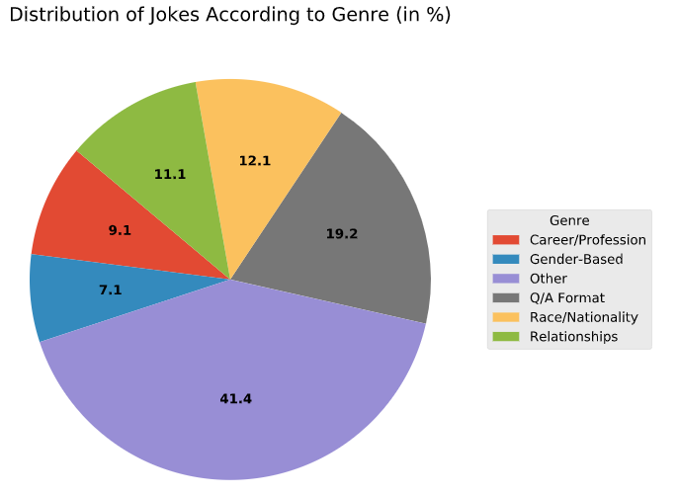
Content Information from Data
TOP GENRES
Q/A FORMAT
Race/ Nationality
Relationships
Other Joke Categories with 1-2 jokes each: Family, Animals, Current Affairs, Politics etc

Slide 12
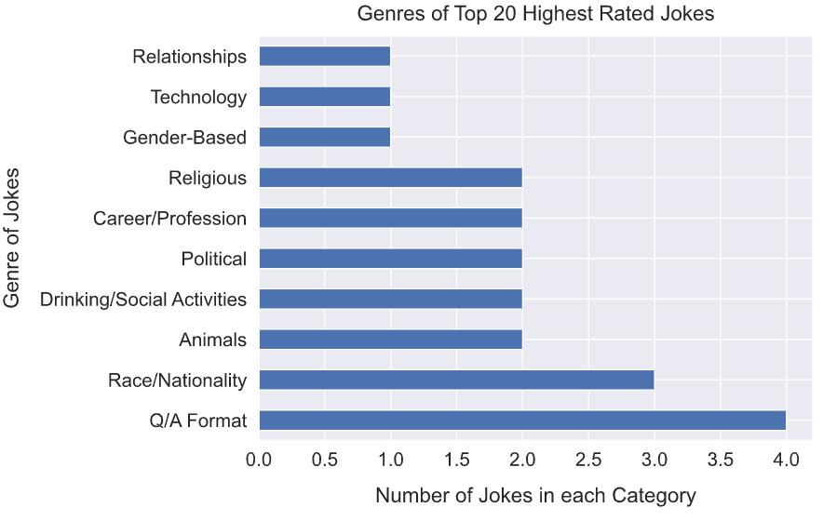
Content Information from Data
JOKES ON “RACE/NATIONALITY”
ARE LIKED BY MOST USERS
JOKES IN Q/A FORMAT ARE ALSO HIGHLY RATED

Slide 13
Let’s Start Recommending Jokes!

Slide 14


User-based Collaborative Filtering (UBCF)
User A
Jokes read and rated by both users
Jokes rated highly by A
Pearson/Cosine similarity
Recommend to B
User B

Slide 15
User-based Collaborative Filtering (UBCF)
1
2
Compute similarity between users using
Pearson Correlation or
Cosine Similarity
Select ‘Top N’ Neighbors based on computed similarity score with
our new user
UBCF
METHOD
Recommend joke to
user based on the Maximum Score
Calculate the score
for each joke based on
each user's score and similarity score
4
3

Slide 16
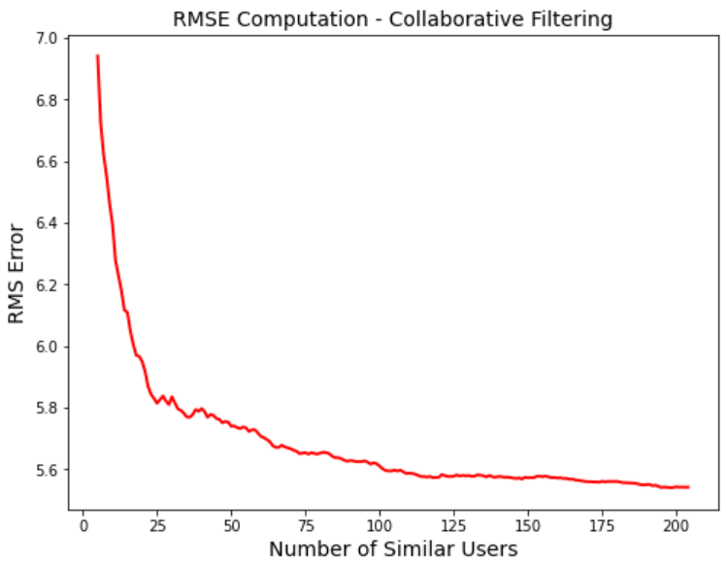
UBCF - Finding Optimum Number of Similar Users
Finding ‘optimum’ value of similar users to use for Collaborative Filtering
Calculating RMS Error by removing part of the dataset and computing the error between the actual ranking and the calculated ranking.
Error almost flattens at 90-100. Ideal value!
“Optimal” Number of Similar Users = 90-100

Slide 17
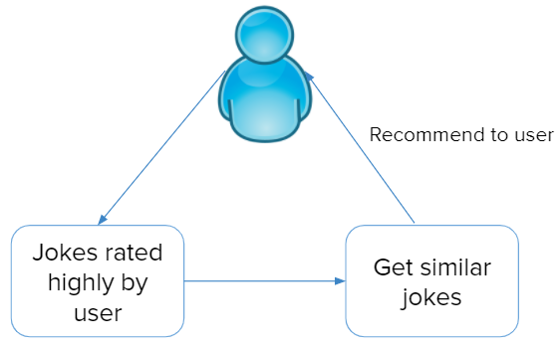
Content-based Filtering

Slide 18
Content-based Filtering
Create a profile of the key words of the jokes rated by our user who needs recommendations
Recommend new jokes based on distance between user profile and joke database
1
2
3
4
Find top N key words using TF-IDF scores for the jokes in the dataset
Compute Cosine Similarity between the unseen jokes and the rated jokes

Slide 19
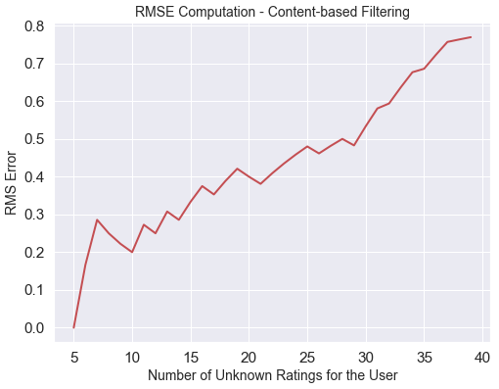
Content-based Filtering: RMSE Computation
Calculating RMS Error by removing part of the dataset and computing the error between the actual ranking and the calculated ranking.
The RMS Error is increasing with the number of unknowns, as expected

Slide 20
Results

Slide 21
Ok Google, Tell Me a Joke...
FOR A NEW USER who hasn’t rated any of the jokes
Our Recommender will randomly display one of the top 20 highest rated jokes!
Son: “Mom, I got a role in a school play. I play a husband”
Mother: “Go back and tell them you want a speaking role”

Slide 22
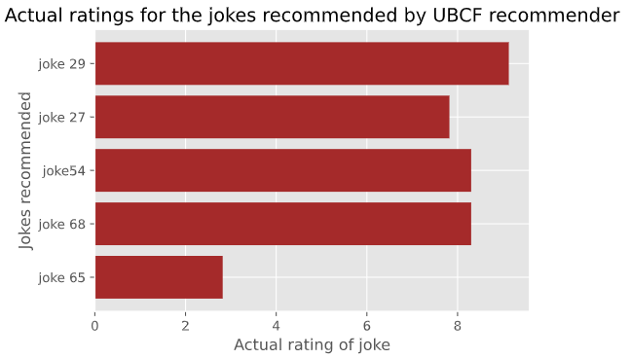
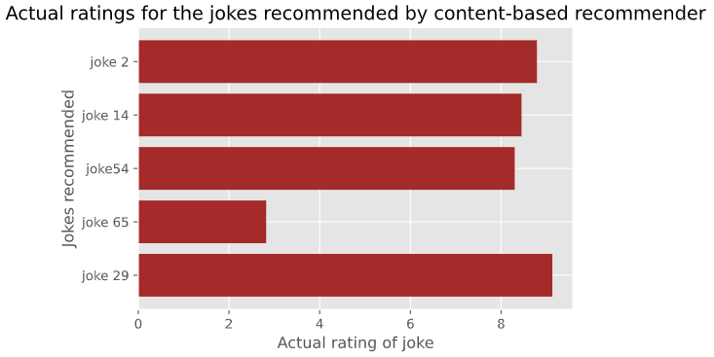

Results: UBCF vs Content-based
Sample results for a new user who has rated few jokes using UBCF and content-based recommenders:

Slide 23
Conclusions and Limitations
Performance of UBCF and Content-based recommender is comparable, but since humor is subjective, a more effective content-based recommender would be ideal. Small Dataset: Insufficient number of jokes (100) to build a good content-based recommender
Data Sparsity: Missing ratings in the dataset can lead to inaccurate recommendations

Slide 24

Future Scope
Find datasets with more jokes and ratings to build a good content-based recommender system.
Implement other neighbor selection techniques to improve the efficiency of UBCF
Effectively combine multiple recommendation schemes to create the best one

Slide 25
THANK YOU! QUESTIONS?

